Slide 1
CS F415: Data Mining
Yashvardhan Sharma

Slide 2
Today’s Outline
Course Operational Details
Introduction
  Motivation
  What is Data Mining
  Origins of Data Mining

Slide 3
Course Operational Details
Instructor-in-charge : YASHVARDHAN SHARMA (yash@pilani.bits-pilani.ac.in)
Lab Instructor : Arshveer Kaur (p20170432@pilani.bits-pilani.ac.in)
Group of Professional Assistants
Course website: nalanda.bits-pilani.ac.in
Email: yash@pilani.bits-pilani.ac.in
Chamber Consultation Hour: Thursday 5pm to 6pm @6111-C
Text Book:
  Tan P. N., Steinbach M & Kumar V. “Introduction to Data Mining” Pearson Education, 2016.
Reference Books
    Han J & Kamber M, “Data Mining: Concepts and Techniques”, Morgan Kaufmann Publishers, Third Edition, 2012
    Zaki MJ & Wagner M JR, “Data Mining and Analysis-Fundamental Concepts and Algorithms” Cameridge Univ Press, 2014.
    Dunhum M.H. & Sridhar S. “Data Mining-Introductory and Advanced Topics”, Pearson Education, 2006.

Slide 4
Evaluation Components
MidSem Test [30%]+Assignments[30%]+ Compre[40%]=Total[100%]
Assignments scope:
  Project– 10 -Term Paper [Group]
  Lab Attendance & Online Test – 5 + 15 [Individual]

Slide 5

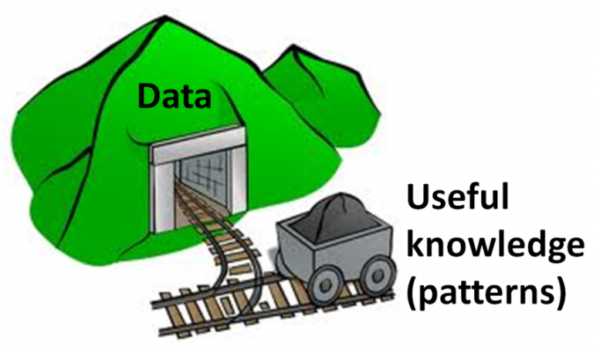

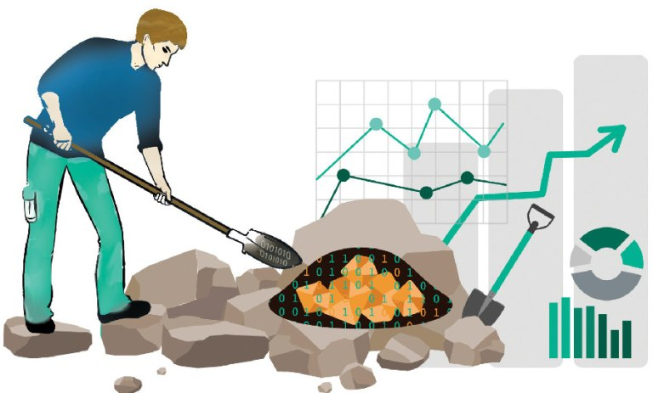

Slide 6
Motivation
Initially, the goal of information systems were to gather information about a specific domain to support decision making.
Nowadays, computerized organizations with transactional software applications have specialized information systems towards a different goal: to support the basic processes in an organization (sales, production, personnel, …).

Slide 7
Motivation
Information Systems are specialized for transactional work.
  So are database models, database design methodologies, database management systems, etc.
These systems are not adequate for analyzing the information or to convey strategic knowledge.
  Inappropriate organization/architecture
  Lack of information-to-knowledge tools

Slide 8
Motivation
Two very different kinds of data processing:
  OLTP (On-Line Transactional Processing):
  transaction-oriented, the typical scenario in an operational database
  OLAP (On-Line Analytical Processing): Oriented to analyse specific issues which are relevant for decision making

Slide 9

Motivation: Commercial Viewpoint
Lots of data is being collected
and warehoused
  Web data, e-commerce
  purchases at department/
  grocery stores
  Bank/Credit Card
  transactions
Computers have become cheaper and more powerful
Competitive Pressure is Strong
  Provide better, customized services for an edge (e.g. in Customer Relationship Management)

Slide 10
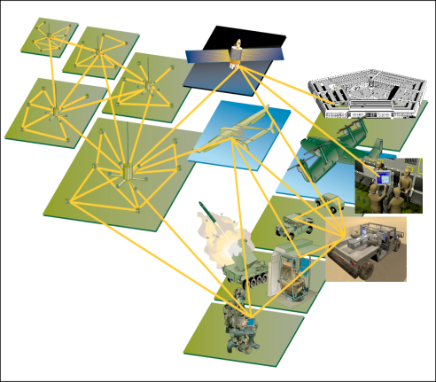

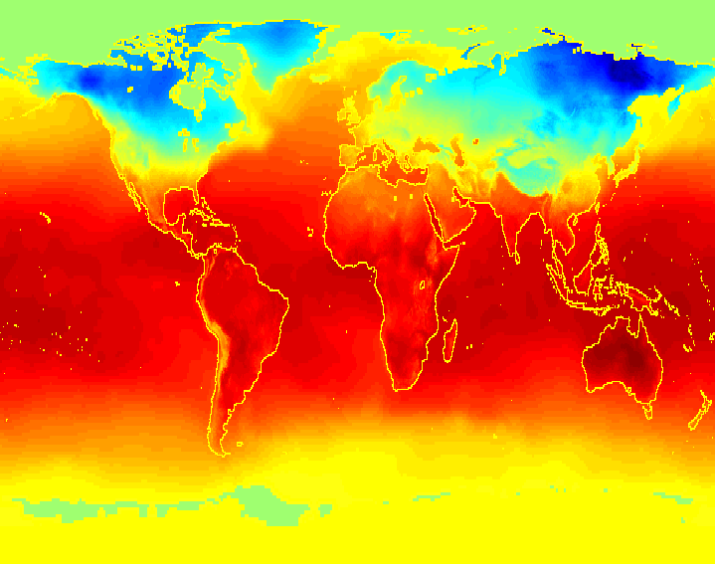
Motivation: Scientific Viewpoint
Data collected and stored at
enormous speeds (GB/hour)
  remote sensors on a satellite
  telescopes scanning the skies
  microarrays generating gene
  expression data
  scientific simulations
  generating terabytes of data
Traditional techniques infeasible for raw data
Data mining may help scientists
  in classifying and segmenting data
  in Hypothesis Formation

Slide 11
Motivation
A (simplistic) view of Data Mining:
Models are the “product” of data mining
--Strategic decisions are supported on the inferred models
Data Mining
Data
(Information)
Models
(Knowledge)

Slide 12
Motivation
Problem
IS’s and DB’s make it possible to convert data into information, but make it difficult to convert information into knowledge.
This cannot be done manually any more.

Slide 13
Motivation
Old tools:
Data Source:
  Transactional Database:
  Relational or Object-Relational Data Organisation
Information Delivery (Exploitation) Tools:
  Batch Reporting Tools
  EIS (Executive Information Systems)
  Traditional DSS (Decision Support Systems)
  Desktop Reporting Tools (Spreadsheet Add-ins,…)

Slide 14
Motivation
New tools:
Data Source:
  Data warehouses or operational data stores.
    Other models: multidimensional
    Other organisations: datamarts
Exploitation tools:
  OLAP (On-Line Analytical Processing) Tools.
  Data Mining
  Simulation

Slide 15
Motivation
Needs and Tools:
Operational decisions → operational queries:
Requirement Examples:
  “Are there available seats for flight IB-2323?”.
» TOOL: SQL.
  “List the products which currently have a special offer”.
    » TOOL: SQL/Reporting tools.

Slide 16
Motivation
Needs and Tools:
Tactical decisions → aggregated queries:
  Requirement Example:
  “Top ten sellers in the sales department during the last year”.
    » TOOL: SQL, OLAP tools, data warehouses
  “Total sales of seaside supermarkets in the second quarter of 2005 vs. total sales of interior supermarkets”.
    » TOOL: DSS, OLAP tools, data warehouses

Slide 17
Motivation
Needs and Tools:
Planning → descriptive or predictive models:
Requirement Examples:
  “Products which are sold together frequently in seaside supermarkets”.
» TOOL: Descriptive Data Mining
  “Sales expected for next quarter for all products in category “multimedia”.
    » TOOL: Predictive Data Mining
  “Expected penetration rates of offer 1 after offer 2 in interior supermarkets”.
» TOOL: Predictive Data Mining + Simulation

Slide 18
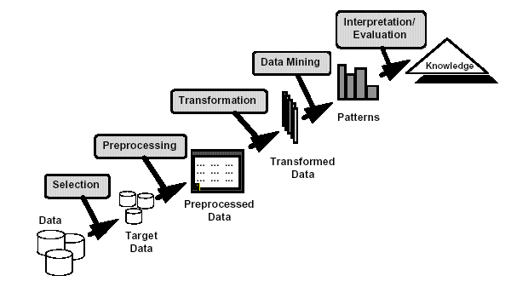
What is Data Mining?
Many Definitions
  Non-trivial extraction of implicit, previously unknown and potentially useful information from data
  Exploration & analysis, by automatic or
  semi-automatic means, of
  large quantities of data
  in order to discover
  meaningful patterns

Slide 19
What is NOT Data Mining?
Originally a “statistician” term
Overusing of data to draw invalid inferences
Bonferroni's theorem warns us that if there are too many possible conclusions to draw, some will be true for purely statistical reasons, with no physical validity.
Famous example: David Rhine, a “parapsychologist" at Duke in the 1950's tested students for Extra Sensory Perception(ESP) by asking them to guess 10 cards - red or black. He found about 1/1000 of them guessed all 10, and instead of realizing that is what you'd expect from random guessing, declared them to have ESP. When he retested them, he found they did no better than average.
His conclusion: telling people they have ESP causes them to lose it!

Slide 20
What is (not) Data Mining?
What is not Data Mining?
  Look up phone number in phone directory
  Query a Web search engine for information about “Amazon”
  What is Data Mining?
  Group together similar documents returned by search engine according to their context (e.g. Amazon rainforest, Amazon.com,)
  customers who buy diapers are more likely to buy beer

Slide 21
Origins of Data Mining
Draws ideas from machine learning/AI, pattern recognition, statistics, and database systems, parallel computing and Distributed Computing
Traditional Techniques
may be unsuitable due to
  Enormity of data
  High dimensionality
  of data
  Heterogeneous,
  distributed nature
  of data
Statistics/
AI
Machine Learning/
Pattern
Recognition
Data Mining
Database systems

Slide 22
Challenges of Data Mining
Scalability
Dimensionality
Complex and Heterogeneous Data
Data Quality
Data Ownership and Distribution
Privacy Preservation
Streaming Data

Slide 23
Data Mining
Learning
Predictive
Descriptive
Classification
Prediction
Summarization
Clustering
Time Series Analysis
Sequence Discovery
Regression
Association Rules

